Slide 1
Linear Control System EC-311
SATISH GUDAPATI
Assistant Professor
Department of Electrical & Electronics Engineering
Chalapathi Institute of Engineering & Technology

Slide 2
Module II – Time Response Analysis
Time Domain Analysis
Transient and Steady State Response
Standard Test Inputs : Step, Ramp, Parabolic and Impulse, Need, Significance
and corresponding Laplace Representation
Poles and Zeros : Definition, S-plane representation
First and Second order Control System
First Order Control System : Analysis for step Input, Concept of Time Constant
Second Order Control System : Analysis for step input, Concept, Definition and
effect of damping
Time Response Specifications
Time Response Specifications ( no derivations )
Tp, Ts, Tr, Td, Mp, ess – problems on time response specifications
Steady State Analysis – Type 0, 1, 2 system, steady state error constants, problems

Slide 3
Module-II
Time Response Analysis

Slide 4
Specific Objectives:
Appreciate the importance of standard inputs and apply them in analysis of control system.
Differentiate between poles and zeros.
Analyze order control system input.
₁st_{& 2}nd
for step
Calculate time response specifications for different systems.
12

Slide 5
Module II – Time Response Analysis
Time Domain Analysis
Transient and Steady State Response
Standard Test Inputs : Step, Ramp, Parabolic and Impulse, Need, Significance
and corresponding Laplace Representation
Poles and Zeros : Definition, S-plane representation
First and Second order Control System
First Order Control System : Analysis for step Input, Concept of Time Constant
Second Order Control System : Analysis for step input, Concept, Definition and
effect of damping
Time Response Specifications
Time Response Specifications ( no derivations )
Tp, Ts, Tr, Td, Mp, ess – problems on time response specifications
Steady State Analysis – Type 0, 1, 2 system, steady state error constants, problems

Slide 6
Time Response
In time domain analysis, time is the independent variable. When a system is given an excitation, there is a response (output).
Definition: The response of a system to an applied excitation is called “Time Response” and it is a function of c(t).
6

Slide 7
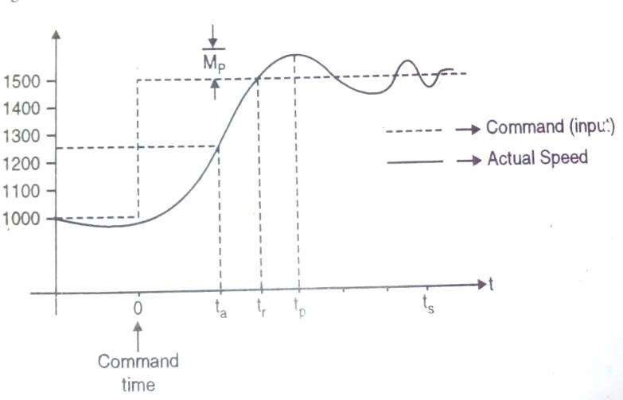
Time Response - Example
The response of motor’s speed when a command is given to increase the speed is shown in figure,
7

Slide 8
As seen from figure, the motors speed gradually picks up
from 1000 rpm and moves towards 1500 rpm. It overshoots and again corrects itself and finally settles
down at the last value
8

Slide 9
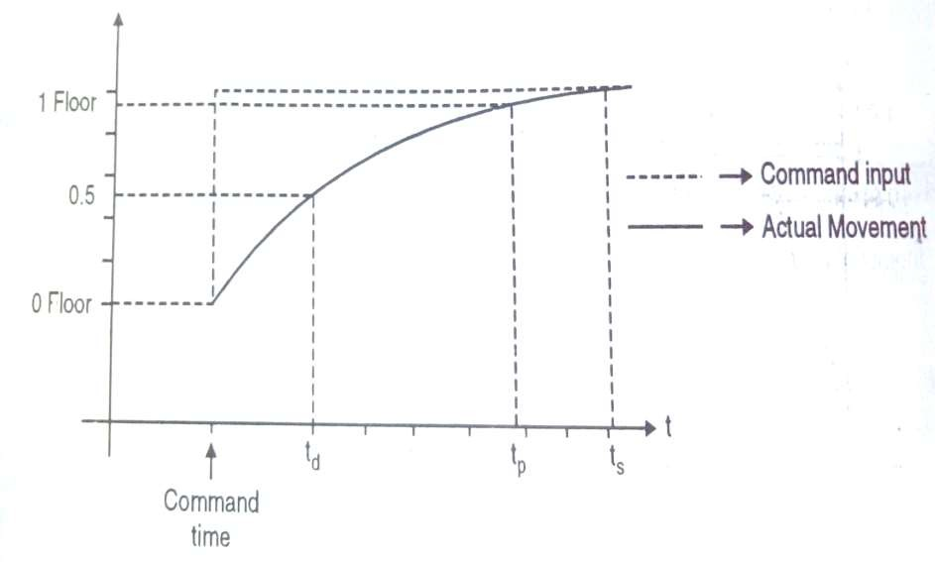
Time Response - Example
The response of lift to a input to move up is shown in figure;
9

Slide 10
Time Response
Generally speaking, the response of any system thus has
two parts
Transient Response
Steady State Response
10

Slide 11
Transient Response
That part of the time response that goes to zero as time becomes very large is called as “Transient Response”
L c(t) = 0
i.e.
As the name suggests that transient response
t →∞
remains only for some time from initial state to final state.
11

Slide 12
Transient Response
From the transient response we can know;
When system begins to respond after an input is given.
How much time it takes to reach the output for the first time.
Whether the output shoots beyond the & how much.
Whether the output oscillates about its final value.
When does it settle to the final value.
desired value
12

Slide 13
Steady State Response
That part of the response that remains after the transients have died out is called “Steady State Response”.
From the steady state we can know;
How long it took before steady state was reached.
Whether there is any error between the desired and actual values.
Whether this error is constant, zero or infinite i.e. unable to track the input.
13

Slide 14
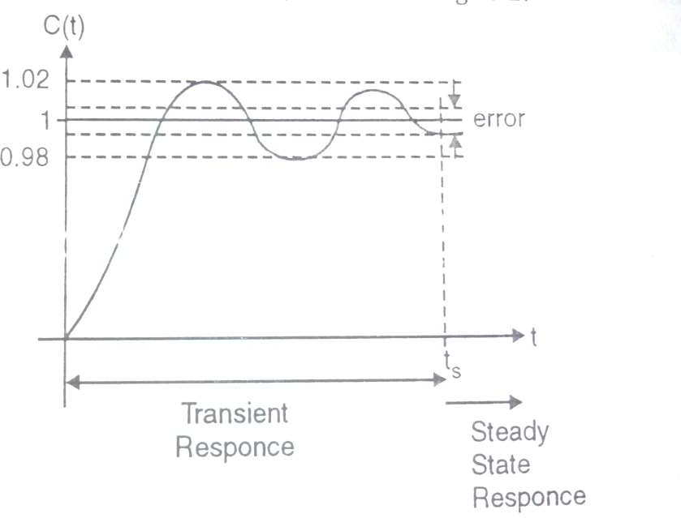
Steady State Response
14

Slide 15
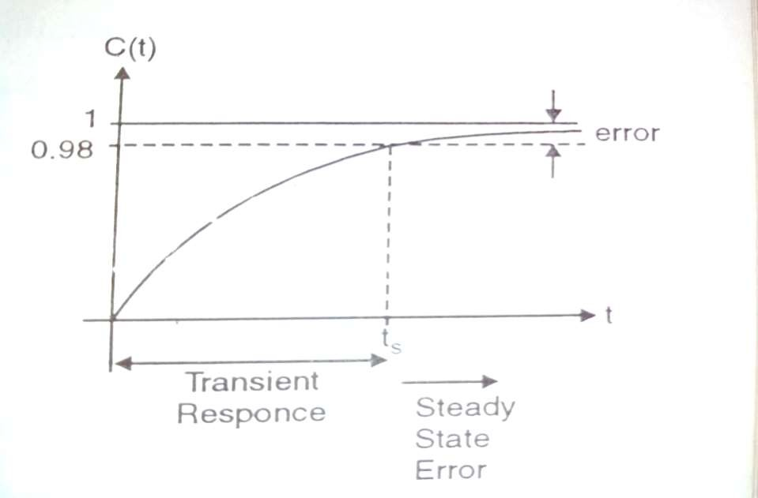
Steady State Response
15

Slide 16
Module II – Time Response Analysis
Time Domain Analysis
Transient and Steady State Response
Standard Test Inputs : Step, Ramp, Parabolic and Impulse, Need, Significance
and corresponding Laplace Representation
Poles and Zeros : Definition, S-plane representation
First and Second order Control System
First Order Control System : Analysis for step Input, Concept of Time Constant
Second Order Control System : Analysis for step input, Concept, Definition and
effect of damping
Time Response Specifications
Time Response Specifications ( no derivations )
Tp, Ts, Tr, Td, Mp, ess – problems on time response specifications
Steady State Analysis – Type 0, 1, 2 system, steady state error constants, problems

Slide 17
Standard Test Signal
It is very interesting fact to know that most control systems do not know what their inputs are going to be.
Thus system design cannot be done from input point of view as we are unable to know in advance the type input
17

Slide 18
Need of Standard Test Signal
From example;
When a radar tracks an enemy plane the nature of the enemy plane’s variation is random.
The terrain, curves on road etc. are random for a drives in an automobile system.
The loading on a shearing machine when and which load will be applied or thrown of.
18

Slide 19
Need of Standard Test Signal
Thus from such types of inputs we can expect a system in general to get an input which may be;
A sudden change
A momentary shock
A constant velocity
A constant acceleration
Hence these signals form standard test signals. The response to these
signals is analyzed. The above inputs are called as,
Step input - Signifies a sudden change
Impulse input – Signifies momentary shock
Ramp input – Signifies a constant velocity
Parabolic input – Signifies constant acceleration
19

Slide 20
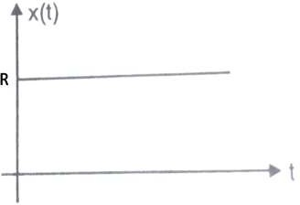
Standard Test Signal
Step Input
Mathematical Representations
Graphical Representations
r(t) = R. u(t)
= 0
t>0 t<0
This signal signifies a sudden change in the reference input r(t) at time t=0
Laplace Representations
L{Ru(t)} = ^{R}
s
20

Slide 21
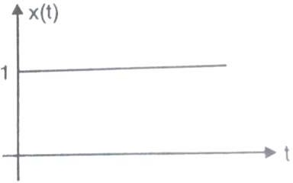
Standard Test Signal
Unit Step Input
Mathematical Representations
Graphical Representations
r(t) = 1.u(t) = 1
= 0
t>0 t<0
This signal signifies a sudden change in the reference input r(t) at time t=0
Laplace Representations
L{u(t)} = ¹
s
21

Slide 22
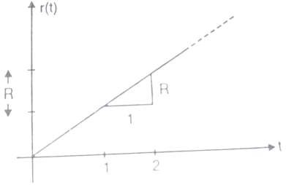
Standard Test Signal
Ramp Input
Mathematical Representations
Graphical Representations
r(t) = R.t
= 0
t>0 t<0
Signal have constant velocity i.e. constant change in it’s value w.r.t. time
R
Laplace Representations
L{Rt} =
_{s}2
22

Slide 23
Standard Test Signal
Unit Ramp Input
Mathematical Representations
Graphical Representations
r(t) = 1.t
= 0
t>0 t<0
If R=1 it is called a unit ramp input
1
Laplace Representations
L{1t} =
_{s}2
23

Slide 24
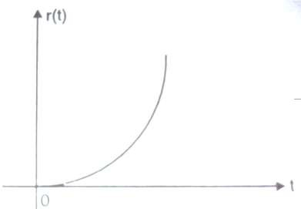
Standard Test Signal
Parabolic Input
Mathematical Representations
Graphical Representations
r(t) =
Rt ²
t>0
2
= 0
t<0
R
Laplace Representations
L{Rt} =
_{s}3
24

Slide 25
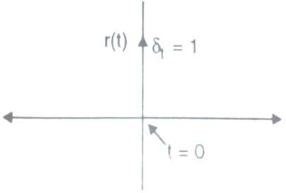
Standard Test Signal
Impulse Input
Graphical Representations
Mathematical Representations
r(t) = δ (t) =1
= 0
t>0
t<0
The function has a unit value only for t=0. In practical cases, a pulse whose
time approaches zero is taken as an impulse function.
L{δ (t)} = 1
Laplace Representations
25

Slide 26
Module II – Time Response Analysis
Time Domain Analysis
Transient and Steady State Response
Standard Test Inputs : Step, Ramp, Parabolic and Impulse, Need, Significance
and corresponding Laplace Representation
Poles and Zeros : Definition, S-plane representation
First and Second order Control System
First Order Control System : Analysis for step Input, Concept of Time Constant
Second Order Control System : Analysis for step input, Concept, Definition and
effect of damping
Time Response Specifications
Time Response Specifications ( no derivations )
Tp, Ts, Tr, Td, Mp, ess – problems on time response specifications
Steady State Analysis – Type 0, 1, 2 system, steady state error constants, problems

Slide 27
Poles & Zeros of Transfer Function
The transfer function is given by,
G(s) = ^{C(s)}
R(s)
Both C(s) and R(s) are polynomials in s
bms^{m} + bm − 1s^{m−1} + ............. + bo
∴G(s) =
_{s}n
+ an − 1s^{n−1} + .................. + an
₌ K (s− b1)(s− b 2)(s− b 3)............(s− bm)
(s− a1)(s− a2)(s− a3)............(s− an)
Where, K= system gain
n= Type of system
27

Slide 28
Poles
The values of ‘s’, for which the transfer function magnitude |G(s)| becomes infinite after substitution in the denominator of the system are called as “Poles” of transfer function.
28

Slide 29
Example 1
Determine the poles of given transfer function.
_{G(s) =} s(s+ 2)(s+ 4)
s(s+ 3)(s+ 4)
Solution: The poles can be obtained by equating denominator with zero
s(s+ 3)(s+ 4) = 0
∴ s = 0
∴s+ 3 = 0
∴s+ 4 = 0
∴s = −3
∴s = −4
The poles are s=0, -3, -4
29

Slide 30
S-plane Representation of Poles
jω
3j 2j j
σ
-2
-1
0
-j
-2j
-3j
-5 -4 -3
30

Slide 31
Zeros
The values of ‘s’, for which the transfer
function magnitude |G(s)| becomes zero after substitution in the numerator of the system are called as “Zeros” of transfer
function.
31

Slide 32
Example 2
Determine the zeros of given transfer function.
_{G(s) =} s(s+ 2)(s+ 4)
s(s+ 3)(s+ 4)
Solution: The zeros can be obtained by equating numerator with zero
s(s+ 2)(s+ 4) = 0
∴ s = 0
∴s+ 2 = 0
∴s+ 4 = 0
∴s = −2
∴s = −4
The poles are s=0, -2, -4
32

Slide 33

S-plane Representation of Zeros
jω
3j 2j j
σ
-2
-1
0
-5 -4 -3
-j
-2j
-3j
33

Slide 34
Pole- Zero Plot
The diagram obtained by locating all poles and zeros of the transfer function in the s-plane is called as “Pole-zero plot”.
The s-plane has two axis real and imaginary. Since
s = σ + jω , the X-axis stands for real axis and shows a value of σ .
Similarly, Y-axis stands for jω and represents imaginary axis.
the
34

Slide 35

Pole- Zero Plot for Example 1 and 2
jω
3j 2j j
σ
-2
-1
0
-5 -4 -3
-j
-2j
-3j
35

Slide 36
Definition: The equation obtained by equating the denominator polynomial of a transfer function to zero is called as the “Characteristics Equation”
Characteristics Equation
_{s}n
+ an − 1s^{n−1} + an − 2s^{n−2} + ............... + an
36

Slide 37
Example 3
For the given transfer function,
K (s+ 6)
T.F. =
s(s+ 2)(s+ 5)(s² + 7 s+ 12)
Find: (i) Poles
(iii) Pole-zero Plot
Solution: (i)Poles
(ii)Zeros
(iv) Characteristics Equation
The poles can be obtained by equating denominator with zero
s(s+ 2)(s+ 5)(s² + 7 s+ 12) = 0
∴ s = 0
∴s+ 2 = 0
∴s+ 5 = 0
∴s = −2
∴s = −5
37

Slide 38
Example 3
Cont….
s(s+ 2)(s+ 5)(s² + 7 s+ 12) = 0
(s² + 7 s+ 12) = (s+ 3)(s+ 4)
∴s+ 3 = 0
∴s+ 4 = 0
The poles are s=0, -2, -3, -4, -5
(ii) Zeros:
∴s = −3
∴s = −4
The zeros can be obtained by equating numerator with zero
s+ 6 = 0
The zeros are s=-6
∴s = −6
38

Slide 39

Example 3
Cont….
(iii) Pole-zero plot:
jω
3j
2j j
σ
-2
-1
0
-6 -5 -4 -3
-j
-2j
-3j
39

Slide 40
Example 3
Cont….
(iv) Characteristics Equation:
s(s+ 2)(s+ 5)(s² + 7 s+ 12) = 0
s(s² + 7 s+ 10)(s² + 7 s+ 12) = 0
∴(s³ + 7 s² + 10s)(s² + 7 s+ 12) = 0
∴s⁵ + 7s⁴ +12s³ + 7s⁴ + 49s³ + 84s² +10s³ + 70s² +120s = 0
∴s⁵ +14s⁴ + 71s³ +154s² +120s = 0
40

Slide 41
Example 4
For the given transfer function,
C(s) ₌ (s+ 2)
R(s) s(s² + 2 s+ 2)(s² + 7 s+ 12)
Find: (i) Poles
(iii) Pole-zero Plot
Solution: (i)Poles
(ii)Zeros
(iv) Characteristics Equation
The poles can be obtained by equating denominator with zero
s(s² + 2s+ 2)(s² + 7 s+ 12) = 0
∴ s = 0
∴s+ 3 = 0
∴s+ 4 = 0
∴s = −3
∴s = −4
41

Slide 42
Example 4
Cont….
s(s² + 2s+ 2)(s² + 7 s+ 12) = 0
_{b}2
−b ± − 4ac
roots =
2a
∴s = −1+ j
∴s = −1− j
The poles are s=0, -3, -4, -1+j,-1-j
(ii) Zeros:
The zeros can be obtained by equating numerator with zero
s+ 2 = 0
The zeros are s=-2
∴s = −2
42

Slide 43
Example 4
Cont….
(iii) Pole-zero plot:
jω
3j 2j j
σ
-2 -1
0
-6 -5 -4 -3
-j
-2j
-3j
43

Slide 44
Example 4
Cont….
(iv) Characteristics Equation:
s(s² + 2s+ 2)(s² + 7 s+ 12) = 0
∴(s³ + 2s² + 2s)(s² + 7 s+ 12) = 0
∴s⁵ + 7s⁴ +12s³ + 2s⁴ +14s³ + 24s² + 2s³ +14s² + 24s = 0
∴s⁵ + 9s⁴ + 28s³ + 38s² + 24s = 0
44

Slide 45
Example 5
For the given transfer function,
(s+ 2)
T.F. =
s(s+ 4)(s² + 6 s+ 25)
Find: (i) Poles
(iii) Pole-zero Plot
Solution: (i)Poles
(ii)Zeros
(iv) Characteristics Equation
The poles can be obtained by equating denominator with zero
s(s+ 4)(s² + 6 s+ 25) = 0
∴ s = 0
∴s+ 4 = 0
∴s = −4
45

Slide 46
Example 5
Cont….
s(s+ 4)(s² + 6 s+ 25) = 0
_{b}2
−b ± − 4ac
roots =
2a
∴s = −3 + j4
∴s = −3 − j4
The poles are s= 0, -4, -3+j4, -3-j4
(ii) Zeros:
The zeros can be obtained by equating numerator with zero
s+ 2 = 0
∴s = −2
The zeros are s=-2
46

Slide 47
Example 5
Cont….
jω
(iii) Pole-zero plot:
4j 3j
2j j
σ
-2 -1
0
-6 -5 -4 -3
-j
-2j
-3j
-4j
47

Slide 48
Example 5
Cont….
(iv) Characteristics Equation:
s(s+ 4)(s² + 6 s+ 25) = 0
(s² + 4s)(s² + 6 s+ 25) = 0
∴s⁴ + 6 s³ + 25s² + 4 s³ + 24 s² +100s = 0
∴s⁴ +10 s³ + 49 s² +100s = 0
48

Slide 49
Module II – Time Response Analysis
Time Domain Analysis
Transient and Steady State Response
Standard Test Inputs : Step, Ramp, Parabolic and Impulse, Need, Significance
and corresponding Laplace Representation
Poles and Zeros : Definition, S-plane representation
First and Second order Control System
First Order Control System : Analysis for step Input, Concept of Time Constant
Second Order Control System : Analysis for step input, Concept, Definition and
effect of damping
Time Response Specifications
Time Response Specifications ( no derivations )
Tp, Ts, Tr, Td, Mp, ess – problems on time response specifications
Steady State Analysis – Type 0, 1, 2 system, steady state error constants, problems

Slide 50
Analysis of first order system for Step input
Consider a first order system as shown;
1
Ts
+
R(s)
C(s)
-
Here
G(s) = ¹
and
H(s) = 1
Ts
G
1
C(s)
∴ =
₌ Ts
1
=
R(s)
1 + GH
1
1 + Ts
1 +
Ts
50

Slide 51
Analysis of first order system for Step input
For step input;
r(t) = u(t)
= 0
t>0 t<0
Taking Laplace transform;
R(s) = L{Ru(t)} = ¹
s
but
C (s) ₌ 1
R(s) 1 + Ts
1
∴ C(s) =
R(s)
1 + Ts
51

Slide 52
Analysis of first order system for Step input
1 × 1 1 + Ts s
∴ C(s) =
Using partial fraction;
∴ C(s) = ^{A} +
B
s
s + ¹
T
Solving;
∴ A = s.C (s) |_{s =0} = 1
∴ B = (s + ¹ )C (s) |
= −1
T
s =− ¹
T
52

Slide 53
Analysis of first order system for Step input
1
∴ C(s) = ¹ −
s
s + ¹
T
Taking Inverse Laplace transform;
1
1
−1
∴ c(t) = L⁻¹{C(s)} = L { } − L⁻¹{
s
}
1
s +
T
¹ t T
∴ c(t) = 1 − e
53

Slide 54
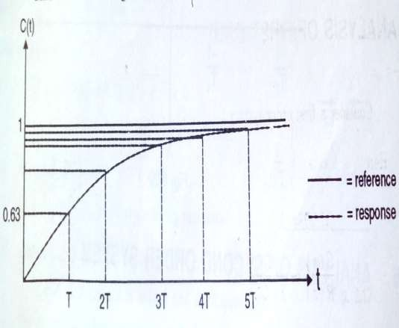
Analysis of first order system for Step input
Plot c(t) vs t;
Sr. No. | t | C(t)
1 | T | 0.632
2 | 2T | 0.86
3 | 3T | 0.95
4 | 4T | 0.982
5 | 5T | 0.993
6 | ∞ | 1
54

Slide 55
Time Constant (T)
The value of c(t)=1 only at t=∞.
Practically the value of c(t) is within 5% of final value at t=3T and within 2% at t=4T.
In practice t=3T or 4T may be taken as steady state.
How quickly the value reaches steady state is a function of the time constant of the system.
Hence smaller T indicates quicker response.
55

Slide 56
Module II – Time Response Analysis
Time Domain Analysis
Transient and Steady State Response
Standard Test Inputs : Step, Ramp, Parabolic and Impulse, Need, Significance
and corresponding Laplace Representation
Poles and Zeros : Definition, S-plane representation
First and Second order Control System
First Order Control System : Analysis for step Input, Concept of Time Constant
Second Order Control System : Analysis for step input, Concept, Definition and
effect of damping
Time Response Specifications
Time Response Specifications ( no derivations )
Tp, Ts, Tr, Td, Mp, ess – problems on time response specifications
Steady State Analysis – Type 0, 1, 2 system, steady state error constants, problems

Slide 57
Damping
Every system has a tendency to oppose the
oscillatory behavior of the system which is known as “Damping”.
57

Slide 58
Damping Factor ( ξ)
The damping in any system is measured by a factor or ratio which is known as damping ratio.
It is denoted by ξ (Zeta)
58

Slide 59
Analysis of second order system for Step input
Consider a second order system as shown;
ωn ²
s(s+ 2ξωn)
R(s) +
C(s)
-
ωn ²
Here
G(s) =
and
H(s) = 1
s(s+ 2ξωn)
ωn ²
∴ C(s) ₌ G
s(s+ 2ξωn)
ωn ²
=
=
_{s}2
R(s)
1 + GH
ωn ²
s(s+ 2ξωn)
+ 2ξωns+ωn ²
1 +
59

Slide 60
Analysis of second order system for Step input
C (s) ₌
ωn ²
R(s)
_{s}2
+ 2ξωns+ωn ²
This is the standard form of the closed loop transfer function
These poles of transfer function are given by;
_{s}2
+ 2ξωns+ωn ² = 0
−2ξωn ±
(2ξωn)² − 4(ωn)²
∴ s =
2
= −ξωn ±
ξ²ωn² −ωn ²
_{ξ}2
= −ξωn ± ωn −1
60

Slide 61
Analysis of second order system for Step input
The poles are;
_{ξ}2
(i) Real and Unequal if
−1 > 0
i.e. They lie on real axis and distinct
ξ> 1
_{ξ}2
(ii) Real and equal if
−1 = 0
i.e. They are repeated on real axis
ξ= 1
_{ξ}2
(iii) Complex if
−1 < 0
i.e.
ξ< 1
Poles are in second and third quadrant
61

Slide 62
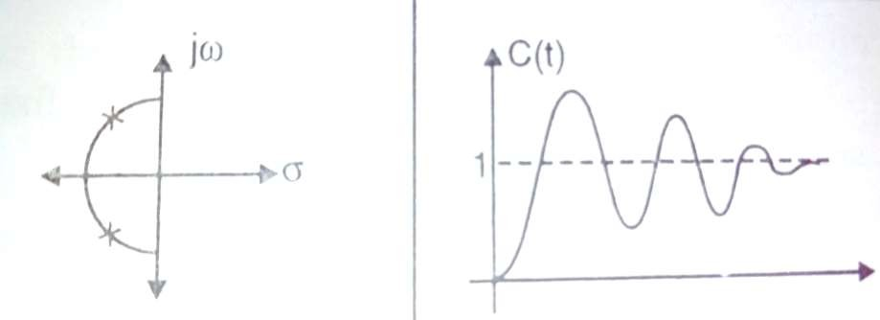
Relation between ξand pole locations
(i) 0 < ξ< 1
Under damped
Pole Location
Step Response c(t)
62

Slide 63
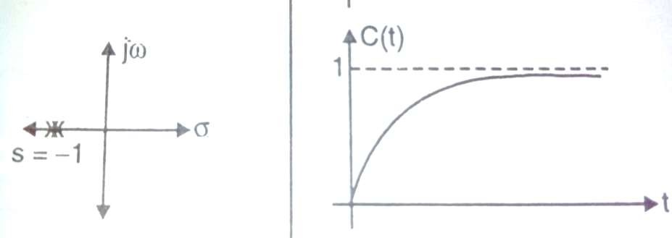
Relation between ξ
and pole locations
ξ= 1
(ii) Critically damped
Pole Location
Step Response c(t)
63

Slide 64
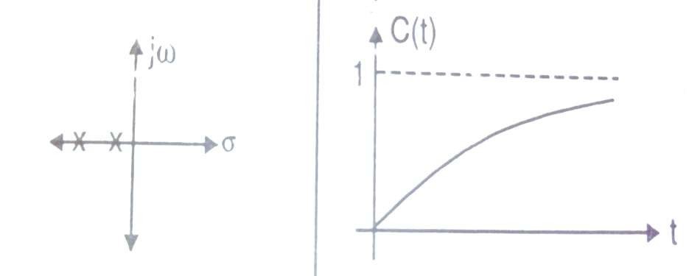
Relation between ξ
and pole locations
(iii)
ξ> 1
over damped
Pole Location
Step Response c(t)
64

Slide 65
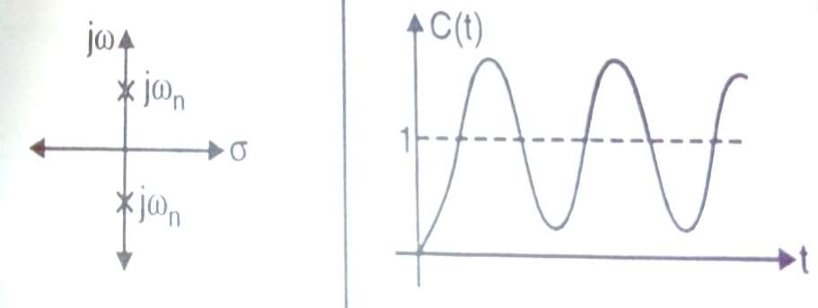
Relation between ξ
and pole locations
(iv)
ξ= 0
Pole Location
Step Response c(t)
65

Slide 66
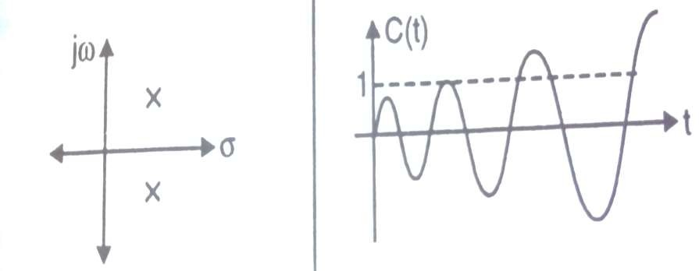
Relation between ξ
and pole locations
(v)
0 > ξ> −1
Step Response c(t)
Pole Location
66

Slide 67
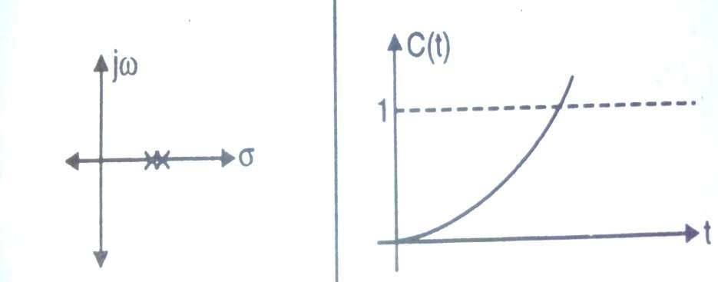
Relation between ξ
and pole locations
ξ= −1
(vi)
Pole Location
Step Response c(t)
67

Slide 68
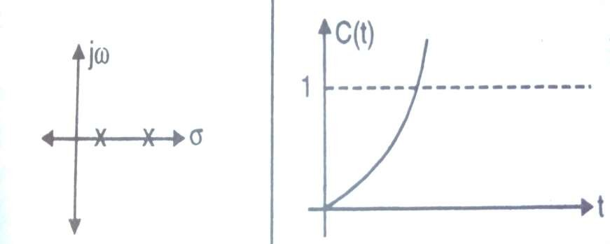
Relation between ξ and pole locations
ξ< −1
(vii)
Pole Location
Step Response c(t)
68

Slide 69
Module II – Time Response Analysis
Time Domain Analysis
Transient and Steady State Response
Standard Test Inputs : Step, Ramp, Parabolic and Impulse, Need, Significance
and corresponding Laplace Representation
Poles and Zeros : Definition, S-plane representation
First and Second order Control System
First Order Control System : Analysis for step Input, Concept of Time Constant
Second Order Control System : Analysis for step input, Concept, Definition and
effect of damping
Time Response Specifications
Time Response Specifications
Tp, Ts, Tr, Td, Mp, ess – problems on time response specifications
Steady State Analysis – Type 0, 1, 2 system, steady state error constants, problems

Slide 70
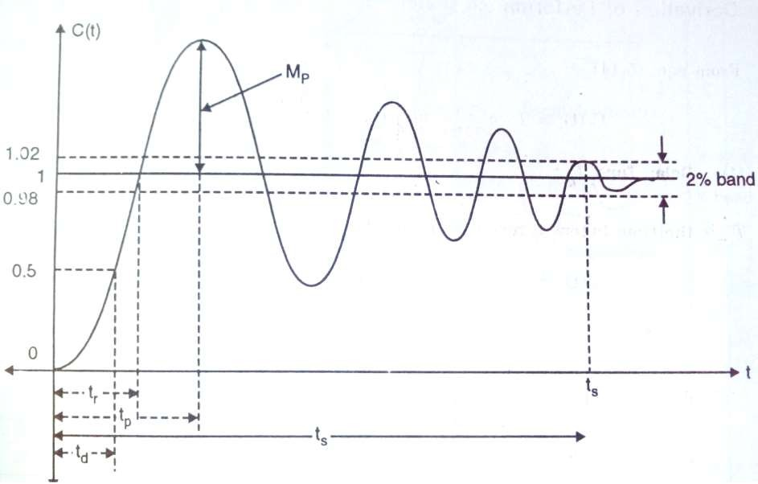
Time Response Specifications
70

Slide 71
Time Response Specifications
Delay Time (t_{d}):
It is time required for the response to reach 50% of the final value in the first attempt.
_{td =} 1+ 0.7ξ
ωn
71

Slide 72
Time Response Specifications
Rise Time (tr):
It is time required for the response to rise from 10% to 90% of the final value for overdamped systems.
(It is 0 to 100% for under damped systems)
_{tr =} π − β
ωd
1−ξ²
β= tan
−1
ξ
where,
and
ωd = ωn 1−ξ²
72

Slide 73
Time Response Specifications
Peak Overshoot (Mp):
The maximum overshoot is the maximum peak value of the response curve measured from unity. It is therefore largest error between input and output during the transient period.
ξπ
−{
}
%Mp = e
1−ξ²
×100
73

Slide 74
Time Response Specifications
Peak Time (tp):
It is the time required for the response to reach the first peak.
π
ωd
Tp =
74

Slide 75
Time Response Specifications
Settling Time (ts):
It is the time required for the response curve to reach and stay within a specified percentage (usually 2% or 5%) of the final value.
4
Ts = 4T =
ξωn
75

Slide 76
Module II – Time Response Analysis
Time Domain Analysis
Transient and Steady State Response
Standard Test Inputs : Step, Ramp, Parabolic and Impulse, Need, Significance
and corresponding Laplace Representation
Poles and Zeros : Definition, S-plane representation
First and Second order Control System
First Order Control System : Analysis for step Input, Concept of Time Constant
Second Order Control System : Analysis for step input, Concept, Definition and
effect of damping
Time Response Specifications
Time Response Specifications
Tp, Ts, Tr, Td, Mp, ess – problems on time response specifications
Steady State Analysis – Type 0, 1, 2 system, steady state error constants, problems

Slide 77
Example 6
A unity feedback system has
16
G(s) =
s(s + 5)
If a step input is given calculate
Damping Ratio
Overshoot
Settling Time
Solution:
16
G(s) =
H (s) = 1
s(s + 5)
Determine the closed loop transfer function
16
C (s) ₌ G s(s + 5)
16
= =
_{s}2
R(s) 1 + GH
16
s(s + 5)
+ 5s + 16
1 +

Slide 78
Example 6 cont……
Compare closed loop TF with standard form of second order system
ωn ²
16
_{s}2
=
_{s}2
+ 2ξωns +ωn ²
+ 5s + 16
Compare denominators of both Natural Frequency;
ωn ² = 16
Damping Ratio;
2ξωns = 5s
∴ωn = 4 rad / sec
5 5
∴ξ=
=
= 0.625
2 ×ωn 2 × 4
Settling Time;
Ts =
4
4
=
= 1.6 sec
ξωn (0.625) × (4)

Slide 79
Example 6
cont……
Overshoot
ξπ
−{
}
%Mp = e
1−ξ²
×100
( 0.625)π
−{
}
%Mp = e
1−( 0.625)²
×100
%Mp = 8.08%

Slide 80
Example 7
A unity feedback system has
100
G(s) =
s(s + 5)
If it is subjected to unit step input determine;
Damped frequency of oscillations
Time for first overshoot
Settling Time
Maximum Peak Overshoot

Slide 81
Example 7
cont……
Solution:
100
G(s) =
H (s) = 1
s(s + 5)
Determine the closed loop transfer function
100
C (s) ₌ G s(s + 5)
100
= =
_{s}2
R(s) 1 + GH
100
+ 5s + 100
1 +
s(s + 5)
Compare closed loop TF with standard form of second order system
ωn ²
100
_{s}2
=
_{s}2
+ 2ξωns +ωn ²
+ 5s + 100
Compare denominators of both
Natural Frequency;
ωn ² = 100
∴ωn = 10 rad / sec

Slide 82
Example 7
cont……
Damping Ratio;
2ξωns = 5s ∴ξ=
Damped frequency of oscillations;
5
5
=
= 0.25
2 ×ωn
2 ×10
ωd = ωn 1 −ξ² ∴ωd = 10 1− (0.25)²
Time for first overshoot (Peak Time);
= 9.68 rad / sec
π
Tp = ^{π} =
= 0.324 sec
ωd 9.68
Settling Time;
4
4
Ts = 4T =
=
= 1.6 sec
ξωn (0.25) × (10)

Slide 83
Example 7
cont……
Maximum Peak Overshoot
%Mp = e
ξπ
−{
}
1−ξ²
×100
( 0.25)π
−{
}
%Mp = e
1−( 0.25)²
×100
%Mp = 44.48%

Slide 84
Example 8
For the unity feedback control system having open loop transfer function
10
G(s) =
s(s + 4)
Determine;
Delay Time
Rise Time
Peak Time
Settling Time
Maximum Peak Overshoot

Slide 85
Example 8
cont……
Solution:
10
G(s) =
H (s) = 1
s(s + 4)
Determine the closed loop transfer function
10
C (s) ₌ G s(s + 4)
10
= =
_{s}2
R(s) 1 + GH
10
+ 4s + 10
1 +
s(s + 4)
Compare closed loop TF with standard form of second order system
ωn ²
10
_{s}2
=
_{s}2
+ 2ξωns +ωn ²
+ 4s + 10
Compare denominators of both
Natural Frequency;
ωn ² = 10 ∴ωn = 3.16 rad / sec

Slide 86
Example 8
cont……
Damping Ratio;
2ξωns = 4s ∴ξ=
Damped frequency of oscillations;
4
4
=
= 0.633
2 ×ωn
2 × 3.16
ωd = ωn 1 −ξ² ∴ωd = 3.16 1− (0.633)²
Delay Time;
= 2.44 rad / sec
₌ 1+ 0.7ξ ₌ 1+ 0.7(0.633) _{= 0.457 sec}
Td
ωn
3.16

Slide 87
Example 8
cont……
Rise Time;
1−ξ²
1− (0.633)²
β= tan ¹ = tan⁻¹ = 0.885 rad
−
ξ
(0.633)
Tr = ^{π− β} = ^{π− 0.885} = 0.92 sec
ωd
(0.244)
Peak Time;
π
Tp = ^{π} =
= 1.273 sec
ωd 2.44
Settling Time;
4
4
Ts = 4T =
=
= 1.997 sec
ξωn (0.633) × (3.16)

Slide 88
Example 8
cont……
Maximum Peak Overshoot
%Mp = e
ξπ
−{
}
1−ξ²
×100
( 0.633)π
−{
}
%Mp = e
1−( 0.633)²
×100
%Mp = 7.66%

Slide 89
Example 9
A second order servo system has a unity feedback,
500
G(s) =
s(s +15)
Determine;
Delay Time
Rise Time
Peak Time
Settling Time
Maximum Peak Overshoot

Slide 90
Example 9
cont……
Solution:
500
G(s) =
H (s) = 1
s(s +15)
Determine the closed loop transfer function
500
C (s) ₌ G s(s + 15)
500
= =
_{s}2
R(s) 1 + GH
500
+ 15s + 500
1 +
s(s + 15)
Compare closed loop TF with standard form of second order system
ωn ²
500
_{s}2
=
_{s}2
+ 2ξωns +ωn ²
+ 15s + 500
By comparing denominators of both
Natural Frequency;
ωn ² = 500 ∴ωn = 22.36 rad / sec

Slide 91
Example 9
cont……
Damping Ratio;
2ξωns = 15s ∴ξ=
Damped frequency of oscillations;
15
15
=
= 0.335
2 ×ωn
2 × 22.36
ωd = ωn 1 −ξ² ∴ωd = 22.36 1− (0.335)²
Delay Time;
= 21.06 rad / sec
₌ 1+ 0.7ξ ₌ 1+ 0.7(0.335) _{= 0.055 sec}
Td
ωn
22.36

Slide 92
Example 9
cont……
Rise Time;
1−ξ²
1− (0.335)²
β= tan ¹ = tan⁻¹ = 1.229 rad
−
ξ
(0.335)
Tr = ^{π− β} = ^{π−1.229} = 0.091 sec
ωd
(21.06)
Peak Time;
π
Tp = ^{π} =
= 32.73 sec
ωd 21.06
Settling Time;
4
4
Ts = 4T =
=
= 0.534 sec
ξωn (0.335) × (22.36)

Slide 93
Example 9
cont……
Maximum Peak Overshoot
%Mp = e
ξπ
−{
}
1−ξ²
×100
( 0.335)π
−{
}
%Mp = e
1−( 0.335)²
×100
%Mp = 32.75%

Slide 94
Example 10
The open loop transfer function of a unity feedback system is,
4
G(s) =
s(s +1)
Determine;
Delay Time
Rise Time
Peak Time
Settling Time
Maximum Peak Overshoot

Slide 95
Example 10
cont……
Solution:
4
G(s) =
H (s) = 1
s(s +1)
Determine the closed loop transfer function
4
C (s) ₌ G s(s + 1)
4
=
=
_{s}2
R(s) 1 + GH
4
+ s + 4
1 +
s(s + 1)
Compare closed loop TF with standard form of second order system
ωn ²
4
_{s}2
=
_{s}2
+ 2ξωns +ωn ²
+ s + 4
By comparing denominators of both
Natural Frequency;
ωn ² = 4 ∴ωn = 2 rad / sec

Slide 96
Example 10
cont……
Damping Ratio;
2ξωns = s ∴ξ=
Damped frequency of oscillations;
1
1
=
= 0.25
2 ×ωn 2 × 2
ωd = ωn 1 −ξ² ∴ωd = 2 1− (0.25)²
Delay Time;
= 1.936 rad / sec
₌ 1+ 0.7ξ ₌ 1+ 0.7(0.25) _{= 0.587 sec}
Td
ωn
2

Slide 97
Example 10
cont……
Rise Time;
1−ξ²
1− (0.25)²
β= tan ¹ = tan⁻¹ = 1.310 rad
−
ξ
(0.25)
Tr = ^{π− β} = ^{π−1.310} = 0.945 sec
ωd
(1.936)
Peak Time;
π
Tp = ^{π} =
= 1.622 sec
ωd 1.936
Settling Time;
4
4
Ts = 4T =
=
= 8 sec
ξωn (0.25) × (2)

Slide 98
Example 10
cont……
Maximum Peak Overshoot
%Mp = e
ξπ
−{
}
1−ξ²
×100
( 0.25)π
−{
}
%Mp = e
1−( 0.25)²
×100
%Mp = 43.26%

Slide 99
Example 11
The open loop transfer function of a unity feedback system is,
25
G(s) =
s(s + 5)
Determine;
Delay Time
Rise Time
Peak Time
Settling Time
Maximum Peak Overshoot

Slide 100
Example 11
cont……
Solution:
25
G(s) =
H (s) = 1
s(s + 5)
Determine the closed loop transfer function
25
C (s) ₌ G s(s + 5)
25
= =
_{s}2
R(s) 1 + GH
25
+ 5s + 25
1 +
s(s + 5)
Compare closed loop TF with standard form of second order system
ωn ²
25
_{s}2
=
_{s}2
+ 2ξωns +ωn ²
+ 5s + 25
By comparing denominators of both
Natural Frequency;
ωn ² = 25 ∴ωn = 5 rad / sec

Slide 101
Example 11
cont……
Damping Ratio;
2ξωns = 5s ∴ξ=
Damped frequency of oscillations;
5
5
=
= 0.5
2 ×ωn 2 × 5
ωd = ωn 1 −ξ² ∴ωd = 5 1− (0.5)²
Delay Time;
= 4.33 rad / sec
₌ 1+ 0.7ξ ₌ 1+ 0.7(0.5) _{= 0.27 sec}
Td
ωn
5

Slide 102
Example 11
cont……
Rise Time;
1−ξ²
1− (0.5)²
β= tan ¹ = tan⁻¹[
−
] = 1.24 rad
ξ
(0.5)
Tr = ^{π− β} = ^{π−1.04} = 0.485 sec
ωd
(4.330)
Peak Time;
π
Tp = ^{π} =
= 0.725 sec
ωd 4.330
Settling Time;
4
4
Ts = 4T =
=
= 1.6 sec
ξωn (0.5) × (5)

Slide 103
Example 11
cont……
Maximum Peak Overshoot
%Mp = e
ξπ
−{
}
1−ξ²
×100
( 0.5)π
−{
}
%Mp = e
1−( 0.5)²
×100
%Mp = 16.30%

Slide 104
Example 12
The closed loop transfer function of a unity feedback system is,
C(s) ₌ 10
R(s)
_{s}2
+ 4s + 5
Determine;
Delay Time
Rise Time
Peak Time
Settling Time
Maximum Peak Overshoot

Slide 105
Example 12
cont……
Solution:
The given closed loop transfer function is,
C (s) ₌ 10
_{s}2
R(s) + 4s + 5
Compare closed loop TF with standard form of second order system
ωn ²
10
_{s}2
=
_{s}2
+ 2ξωns +ωn ²
+ 4s + 5
By comparing denominators of both Natural Frequency;
ωn ² = 5 ∴ωn = 2.23 rad / sec

Slide 106
Example 12
cont……
Damping Ratio;
2ξωns = 4s ∴ξ=
Damped frequency of oscillations;
4
4
=
= 0.896
2 ×ωn
2 × 2.23
ωd = ωn 1 −ξ² ∴ωd = 2.23 1− (0.896)²
Delay Time;
= 0.99 rad / sec
₌ 1+ 0.7ξ ₌ 1+ 0.7(0.896) _{= 0.72 sec}
Td
ωn
2.23

Slide 107
Example 12
cont……
Rise Time;
1−ξ²
1− (0.896)²
β= tan ¹ = tan⁻¹[
−
] = 0.46 rad
ξ
(0.896)
Tr = ^{π− β} = ^{π− 0.46} = 2.70 sec
ωd
(0.99)
Peak Time;
π
Tp = ^{π} =
= 2.1515 sec
ωd 0.99
Settling Time;
4
4
Ts = 4T =
=
= 2.00 sec
ξωn (0.896) × (2.23)

Slide 108
Example 12
cont……
Maximum Peak Overshoot
%Mp = e
ξπ
−{
}
1−ξ²
×100
( 0.896 )π
−{
}
%Mp = e
1−( 0.896 )²
×100
%Mp = 0.17%

Slide 109
Example 13
The closed loop transfer function of a unity feedback system is,
C(s) ₌
100
R(s)
_{s}2
+15s +100
Determine;
Delay Time
Rise Time
Peak Time
Settling Time
Maximum Peak Overshoot

Slide 110
Example 13
cont……
Solution:
The given closed loop transfer function is,
C (s) ₌ 100
_{s}2
R(s) + 15s + 100
Compare closed loop TF with standard form of second order system
ωn ²
100
_{s}2
=
_{s}2
+ 2ξωns +ωn ²
+ 15s + 100
By comparing denominators of both Natural Frequency;
ωn ² = 100 ∴ωn = 10 rad / sec

Slide 111
Example 13
cont……
Damping Ratio;
2ξωns = 15s ∴ξ=
Damped frequency of oscillations;
15
15
=
= 0.75
2 ×ωn
2 ×10
ωd = ωn 1 −ξ² ∴ωd = 10 1− (0.75)²
Delay Time;
= 6.61 rad / sec
₌ 1+ 0.7ξ ₌ 1+ 0.7(0.75) _{= 0.135 sec}
Td
ωn
10

Slide 112
Example 13
cont……
Rise Time;
1−ξ²
1− (0.75)²
β= tan ¹ = tan⁻¹[
−
] = 0.722 rad
ξ
(0.75)
Tr = ^{π− β} = ^{π− 0.722} = 0.365 sec
ωd
(6.61)
Peak Time;
π
Tp = ^{π} =
= 0.474 sec
ωd 6.61
Settling Time;
4
4
Ts = 4T =
=
= 0.533 sec
ξωn (0.75) × (10)

Slide 113
Example 13
cont……
Maximum Peak Overshoot
%Mp = e
ξπ
−{
}
1−ξ²
×100
( 0.75)π
−{
}
%Mp = e
1−( 0.75)²
×100
%Mp = 2.83%

Slide 114
Example 14
The closed loop transfer functions of certain second order unity feedback control system is,
C(s) ₌ 8
_{s}2
R(s) + 3s + 8
Determine the type of damping in the system.

Slide 115
Example 14
cont……
Solution:
The given closed loop transfer function is,
C (s) ₌ 8
_{s}2
R(s) + 3s + 8
Compare closed loop TF with standard form of second order system
ωn ²
8
_{s}2
=
_{s}2
+ 2ξωns +ωn ²
+ 3s + 8
By comparing denominators of both
Natural Frequency;
ωn ² = 8
∴ωn = 2.82 rad / sec
Damping Ratio;
3 3
2ξωns = 3s ∴ξ=
= = 0.53
2 ×ωn
2 × 2.82
Since ξ< 1, it is an underdamped system.

Slide 116
Example 15
The closed loop transfer functions of certain second order unity feedback control system is,
C(s) ₌ 2
_{s}2
R(s) + 4s + 2
Determine the type of damping in the system.

Slide 117
Example 15
cont……
Solution:
The given closed loop transfer function is,
C (s) ₌ 2
_{s}2
R(s) + 4s + 2
Compare closed loop TF with standard form of second order system
ωn ²
2
_{s}2
=
_{s}2
+ 2ξωns +ωn ²
+ 4s + 2
By comparing denominators of both
Natural Frequency;
ωn ² = 2
∴ωn = 1.414 rad / sec
Damping Ratio;
4 4
2ξωns = 4s ∴ξ=
= = 1.41
2 ×ωn
2 ×1.414
Since ξ> 1 , it is an overdamped system.

Slide 118
Example 16
The closed loop transfer functions of certain second order unity feedback control system is,
C(s) ₌ 2
_{s}2
R(s) + 2s +1
Determine the type of damping in the system.

Slide 119
Example 16
cont……
Solution:
The given closed loop transfer function is,
C (s) ₌ 2
_{s}2
R(s) + 2s + 1
Compare closed loop TF with standard form of second order system
ωn ²
2
_{s}2
=
_{s}2
+ 2ξωns +ωn ²
+ 2s + 1
By comparing denominators of both
Natural Frequency;
ωn ² = 1
∴ωn = 1 rad / sec
Damping Ratio;
2 2
2ξωns = 2s ∴ξ=
=
= 1
2 ×ωn 2 ×1
Since ξ= 1, it is an critically damped system.

Slide 120
Example 17
The closed loop transfer functions of certain second order unity feedback control system is,
C(s) ₌ 2
_{s}2
R(s) + 4
Determine the type of damping in the system.

Slide 121
Example 17
cont……
Solution:
The given closed loop transfer function is,
C (s) ₌ 2
_{s}2
R(s) + 4
Compare closed loop TF with standard form of second order system
ωn ²
2
_{s}2
=
_{s}2
+ 2ξωns +ωn ²
+ 4
By comparing denominators of both
Natural Frequency;
ωn ² = 4
∴ωn = 2 rad / sec
Damping Ratio;
2ξωns = 0
∴ξ= 0
Since ξ= 0, it is an undamped system.

Slide 122
Module II – Time Response Analysis
Time Domain Analysis
Transient and Steady State Response
Standard Test Inputs : Step, Ramp, Parabolic and Impulse, Need, Significance
and corresponding Laplace Representation
Poles and Zeros : Definition, S-plane representation
First and Second order Control System
First Order Control System : Analysis for step Input, Concept of Time Constant
Second Order Control System : Analysis for step input, Concept, Definition and
effect of damping
Time Response Specifications
Time Response Specifications ( no derivations )
Tp, Ts, Tr, Td, Mp, ess – problems on time response specifications
Steady State Analysis – Type 0, 1, 2 system, steady state error constants, problems

Slide 123
Type of System
The open loop transfer function of unity feedback system can be written in two standard forms: the time constant form and the pole-zero form.
_{G(s) =} K (s+ z1)(s+ z 2)..................
(Pole-zero form)
s^{n} (s+ p1)(s+ p 2)................
_{G(s) =} K (1 + T z1s)(1 + T z 2s)..................
(Time constant form)
s^{n} (1 + T p1s)(1 + T p 2s)................

Slide 124
Type-0 (Zero) System
Definition: A control system with no integration in the open loop transfer function and no pole of transfer function G(s) at the origin of s-plane is designated as “Type-0 ” system.
_{G(s) =} K (1 + T z1s)(1 + T z 2s)..................
(Standard form)
(1 + T p1s)(1 + T p 2s)................
An amplifier type control system is a practical example of Type-0 system

Slide 125
Type-1 (One) System
Definition: A control system with one integration in the open loop transfer function and one pole of transfer function G(s) at the origin of s-plane is designated as “Type-1 ” system.
_{G(s) =} K (1 + T z1s)(1 + T z 2s)..................
(Standard form)
s(1 + T p1s)(1 + T p 2s)................
An pneumatic type control system is a practical example of Type-1 system

Slide 126
Type-2 (Two) System
Definition: A control system with two integration in the open loop transfer function and two pole of transfer function G(s) at the origin of s-plane is designated as “Type-2 ” system.
_{G(s) =} K (1 + T z1s)(1 + T z 2s)..................
(Standard form)
s² (1 + T p1s)(1 + T p 2s)................
A mechanical displacement system is a practical example of Type-2 system

Slide 127
Derivation of Steady State Error
The steady state response is important to judge the accuracy of the output. The difference between the steady state response and desired reference gives the steady state error.
R(s)
+
E(s) = R(s) − C(s).H(s)
E(s)
G(s)
C(s)
₊-
But
C(s) = G(s).E(s)
E(s) = R(s) − G(s).E(s).H(s)
R(s) = E(s) + G(s).E(s).H(s)
B(s)
H(s)
For given figure,
E(s) = R(s) − B(s)
But
B(s) = C(s).H(s)
R(s) = E(s){1 + G(s).H(s)}
R(s)
E(s) =
1 ± G(s).H(s)

Slide 128
Derivation of Steady State Error
In time domain,
e(t) = L⁻¹ E(s)
and is the expression of error valid for all time. Steady state error is defined as,
Steady state error,
ess(t) = lim sE(s)
s→0
sR(s)
ess(t) = lim e(t)
ess(t) = lim
t →∞
^{s→0} 1 + G(s) H(s)
From the final value theorem in
Laplace transform,
ess(t) = lim sE(s)
s→0

Slide 129
Steady state error and Standard Signals
Steady state error for step input:
A step input of magnitude A is applied,
r(t) = A. u(t)
= 0
Taking Laplace transform,
t>0 t<0
A
R(s) = L{r(t)} = L{A} =
s
Steady state error,
sR(s)
ess(t) = lim
^{s→0} 1 + G(s) H(s)

Slide 130
Steady state error and Standard Signals
Steady state error for step input:
_{s} A
ess(t) = lim ^{s}
^{s→0} 1 + G(s) H(s)
A
ess(t) = lim
^{s→0} 1 + G(s) H(s)
A
ess(t) =
1 + lim G(s) H(s)
s→0
A
ess(t) =
1 + Kp

Slide 131
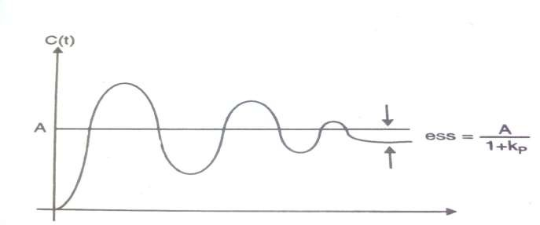
Steady state error and Standard Signals
Steady state error for step input:
The position error constant Kp of a system is defined as,
Kp = limG(s).H(s)
s→0
When a step input of magnitude A is given, in response to
A
this gives ess(t) =
steady state error
1 + Kp
*Kp depends on type of system

Slide 132
Steady state error and Standard Signals
Steady state error for ramp input:
A ramp input of slope A is applied,
r(t) = A.t
= 0
Taking Laplace transform,
t>0 t<0
A
R(s) = L{r(t)} = L{At} =
_{s}2
Steady state error,
sR(s)
ess(t) = lim
^{s→0} 1 + G(s) H(s)

Slide 133
Steady state error and Standard Signals
Steady state error for ramp input:
_{s} A _{s}2
ess(t) = lim
^{s→0} 1 + G(s) H(s)
A
ess(t) = lim ^{s}
^{s→0} 1 + G(s) H(s)
A
ess(t) = lim
^{s→0} s + sG(s) H(s)
A
A
ess(t) =
ess(t) =
0 + lim sG(s) H(s)
Kv
s→0

Slide 134
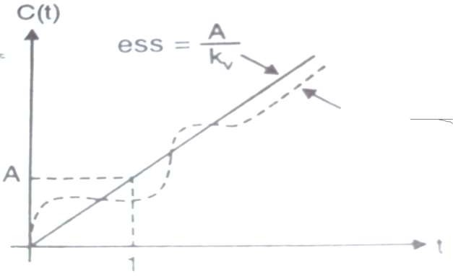
Steady state error and Standard Signals
Steady state error for ramp input:
The velocity error constant Kv of a system is defined as,
Kv = lim sG(s).H(s)
s→0

Slide 135
Steady state error and Standard Signals
Steady state error for parabolic input:
A parabolic input of slope coefficient A/2 is applied,
At ²
r(t) =
2
t>0 t<0
= 0
Taking Laplace transform,
R(s) = L{r(t)} = L{^{A} t ² } =
2
Steady state error,
A
_{s}3
sR(s)
ess(t) = lim
^{s→0} 1 + G(s) H(s)

Slide 136
Steady state error and Standard Signals
Steady state error for parabolic input:
_{s} A _{s}3
ess(t) = lim
^{s→0} 1 + G(s) H(s)
A
_{s}2
ess(t) = lim
^{s→0} 1 + G(s) H(s)
A
ess(t) = lim
s→0 _{s}²
s²G(s) H(s)
A
A
ess(t) =
ess(t) =
0 + lim s²G(s) H(s)
Ka
s→0

Slide 137
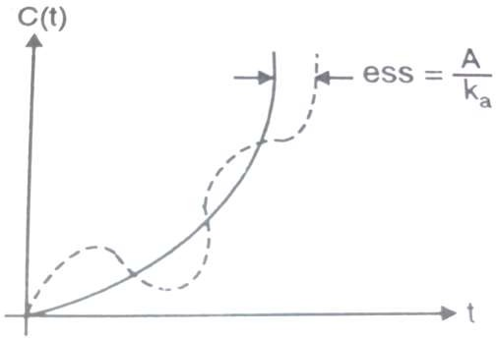
Steady state error and Standard Signals
Steady state error for parabolic input:
The acceleration error constant Ka of a system is defined as,
Ka = lim s²G(s).H(s)
s→0

Slide 138
Steady state error and Standard Signals
Summary:
Sr. No. | Input Signal | Steady State Error | Constant | Constant Expression
1 | Step Input | ess(t) = ^{A} 1 + Kp | Position Error Constant | Kp = limG(s).H(s) s→0
2 | Ramp Input | ess(t) = ^{A} Kv | Velocity Error Constant | Kv = lim sG(s).H(s) s→0
3 | Parabolic Input | ess(t) = ^{A} Ka | Acceleration Error Constant | Ka = lim s²G(s).H(s) s→0

Slide 139
Relation between steady state error and Type of system
The type of system means the number of poles G(s)H(s) at s=0. Consider the general form,
_{G(s).H(s) =} K (1 + T 1 s)(1 + T 2 s)................(1 + Tms)
s^{n} (1 + T a s)(1 + T b s)................(1 + Tns)
Here there are n poles at s=0. Hence the type of system is n.

Slide 140
Steady state error for Step input for Type 0 system
For type zero system, n=0
_{G(s).H(s) =} K (1 + T 1 s)(1 + T 2 s)................(1 + Tms)
(1 + T a s)(1 + T b s)................(1 + Tns)
The position error constant is given by,
Kp = limG(s).H(s)
s→0
_{Kp = lim} K (1 + T 1 s)(1 + T 2 s)................(1 + Tms)
s→0
(1 + T a s)(1 + T b s)................(1 + Tns)
_{Kp =} K (1 + T 10)(1 + T 20)................(1+ Tm 0)
(1 + T a0)(1 + T b0)................(1+ Tn 0)

Slide 141
Steady state error for Step input for Type 0 system
_{Kp =} K (1)(1)................(1)
(1)(1)................(1)
Kp = K
The steady state error is given by,
A
ess(t) =
1 + Kp
A
ess(t) =
1 + K

Slide 142
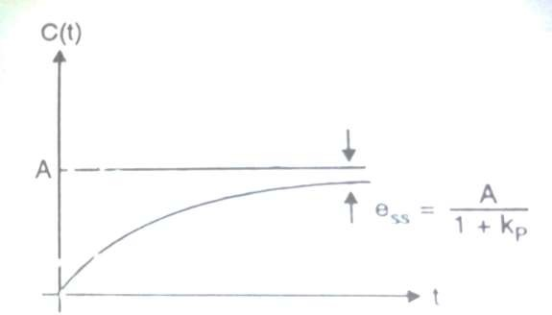
Steady state error for Step input for Type 0 system
A
ess(t) =
1 + K
A type zero system has a finite steady state error to a step
input ,

Slide 143
Steady state error for Step input for Type 1 system
For type one system, n=1
_{G(s).H(s) =} K (1 + T 1 s)(1 + T 2 s)................(1 + Tms)
s(1 + T a s)(1 + T b s)................(1+ Tns)
The position error constant is given by,
Kp = limG(s).H(s)
s→0
_{Kp = lim} K (1 + T 1 s)(1 + T 2 s)................(1 + Tms)
s→0
s(1 + T a s)(1 + T b s)................(1 + Tns)
_{Kp =} K (1 + T 10)(1 + T 20)................(1+ Tm 0)
0(1 + T a0)(1 + T b0)................(1 + Tn 0)

Slide 144
Steady state error for Step input for Type 1 system
_{Kp =} K (1)(1)................(1)
0
Kp = ∞
The steady state error is given by,
A
ess(t) =
1 + Kp
A
ess(t) =
1 + ∞
ess(t) = 0

Slide 145
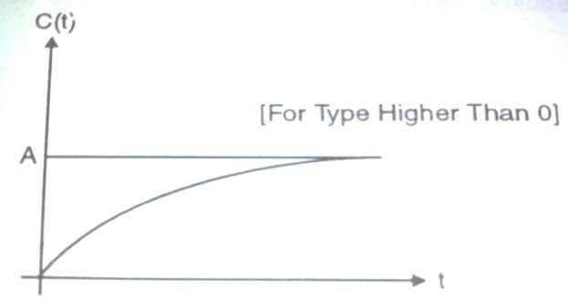
Steady state error for Step input for Type 1 system
ess(t) = 0
A type one system has a zero steady state error to a step input ,

Slide 146
Steady state error for Step input for Type 2 system
For type two system, n=2
_{G(s).H(s) =} K (1 + T 1 s)(1 + T 2 s)................(1 + Tms)
s² (1 + T a s)(1 + T b s)................(1 + Tns)
The position error constant is given by,
Kp = limG(s).H(s)
s→0
_{Kp = lim} K (1 + T 1 s)(1 + T 2 s)................(1 + Tms)
^{s→0} s² (1 + T a s)(1 + T b s)................(1 + Tns)
_{Kp =} K (1 + T 10)(1 + T 20)................(1+ Tm 0)
0(1 + T a0)(1 + T b0)................(1 + Tn 0)

Slide 147
Steady state error for Step input for Type 1 system
_{Kp =} K (1)(1)................(1)
0
Kp = ∞
The steady state error is given by,
A
ess(t) =
1 + Kp
A
ess(t) =
1 + ∞
ess(t) = 0

Slide 148
Steady state error for Step input for Type 1 system
ess(t) = 0
A type two system has a zero steady state error to a step input ,
It is clear that all higher type systems except type zero have zero steady state error.

Slide 149
Steady state error for Ramp input for Type 0 system
For type zero system, n=0
_{G(s).H(s) =} K (1 + T 1 s)(1 + T 2 s)................(1 + Tms)
(1 + T a s)(1 + T b s)................(1 + Tns)
The velocity error constant is given by,
Kv = lim sG(s).H(s)
s→0
_{Kv = lim s{}K (1 + T1 s)(1 + T 2 s)................(1 + Tms)}
s→0
(1 + T a s)(1 + T b s)................(1 + Tns)
_{Kv = 0 ×{}K (1 + T1 s)(1 + T 2 s)................(1 + Tms)}
(1 + T a s)(1 + T b s)................(1 + Tns)

Slide 150
Kv = 0
Steady state error for Ramp input for Type 0 system
The steady state error is given by,
ess(t) = ^{A}
Kv
ess(t) = ^{A}
0
ess(t) = ∞

Slide 151
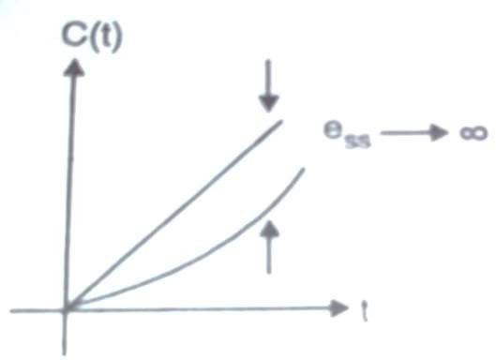
Steady state error for Ramp input for Type 0 system
ess(t) = ∞
The error increase continuously hence type zero system fails
to track a ramp input successfully.

Slide 152
Steady state error for Ramp input for Type 1 system
For type one system, n=1
_{G(s).H(s) =} K (1 + T 1 s)(1 + T 2 s)................(1 + Tms)
s(1 + T a s)(1 + T b s)................(1+ Tns)
The velocity error constant is given by,
Kv = lim sG(s).H(s)
s→0
_{Kv = lim s{}K (1 + T1 s)(1 + T 2 s)................(1 + Tms)}
s→0
s(1 + T a s)(1 + T b s)................(1 + Tns)
_{Kv =} K (1 + T 10)(1 + T 20)................(1 + Tm 0)
(1 + T a0)(1 + T b0)................(1 + Tn 0)

Slide 153
Kv = K
Steady state error for Ramp input for Type 1 system
The steady state error is given by,
ess(t) = ^{A}
Kv
ess(t) = ^{A}
K

Slide 154
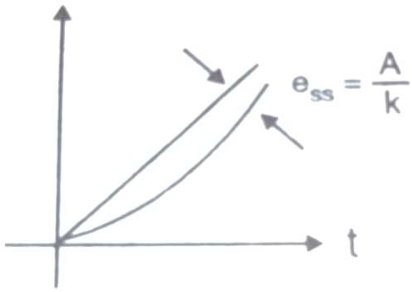
Steady state error for Ramp input for Type 1 system
ess(t) = ^{A}
K
This indicates finite steady state error for type one system for ramp input

Slide 155
Steady state error for Ramp input for Type 2 system
For type two system, n=2
_{G(s).H(s) =} K (1 + T 1 s)(1 + T 2 s)................(1 + Tms)
s² (1 + T a s)(1 + T b s)................(1 + Tns)
The velocity error constant is given by,
Kv = lim sG(s).H(s)
s→0
_{Kv = lim s{}K (1 + T 1 s)(1 + T 2 s)................(1 + Tms)}
s→0
s² (1 + T a s)(1 + T b s)................(1 + Tns)
_{Kv =} K (1 + T 1 s)(1 + T 2 s)................(1 + Tms)
s(1 + T a s)(1 + T b s)................(1 + Tns)

Slide 156
Kv = ∞
Steady state error for Ramp input for Type 2 system
The steady state error is given by,
ess(t) = ^{A}
Kv
ess(t) = ^{A}
∞
ess(t) = 0

Slide 157
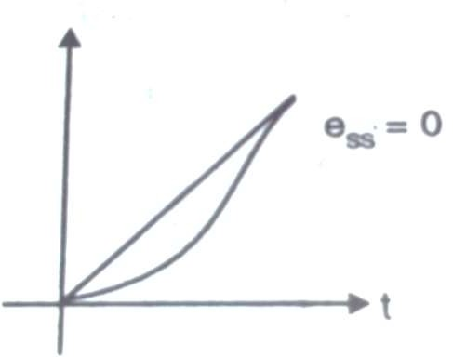
Steady state error for Ramp input for Type 2 system
ess(t) = 0
There is no steady state error for a ramp input for type two
system

Slide 158
Steady state error for Parabolic input for Type 0 system
For type zero system, n=0
_{G(s).H(s) =} K (1 + T 1 s)(1 + T 2 s)................(1 + Tms)
(1 + T a s)(1 + T b s)................(1 + Tns)
The acceleration error constant is given by,
Ka = lim s²G(s).H(s)
s→0
_{Ka = lim s2 {}K (1 + T 1 s)(1 + T 2 s)................(1 + Tms)}
s→0
(1 + T a s)(1 + T b s)................(1 + Tns)
_{Ka = 0 ×{}K (1 + T 1 s)(1 + T 2 s)................(1 + Tms)}
(1 + T a s)(1 + T b s)................(1 + Tns)

Slide 159
Ka = 0
Steady state error for Parabolic input for Type 0 system
The steady state error is given by,
A
ess(t) =
Ka
ess(t) = ^{A}
0
ess(t) = ∞

Slide 160
Steady state error for Parabolic input for Type 0 system
ess(t) = ∞
There is infinite steady state error indicating failure to track a parabolic input in type zero system

Slide 161
Steady state error for Parabolic input for Type 1 system
For type one system, n=1
_{G(s).H(s) =} K (1 + T 1 s)(1 + T 2 s)................(1 + Tms)
s(1 + T a s)(1 + T b s)................(1+ Tns)
The acceleration error constant is given by,
Ka = lim s²G(s).H(s)
s→0
_{Ka = lim s2 {}K (1 + T 1 s)(1 + T 2 s)................(1 + Tms)}
s→0
s(1 + T a s)(1 + T b s)................(1 + Tns)
_{Ka = 0 ×{}K (1 + T 1 s)(1 + T 2 s)................(1 + Tms)}
(1 + T a s)(1 + T b s)................(1 + Tns)

Slide 162
Ka = 0
Steady state error for Parabolic input for Type 1 system
The steady state error is given by,
A
ess(t) =
Ka
ess(t) = ^{A}
0
ess(t) = ∞

Slide 163
Steady state error for Parabolic input for Type 1 system
ess(t) = ∞
There is infinite steady state error indicating failure to track a parabolic input in type one system

Slide 164
Steady state error for Parabolic input for Type 2 system
For type two system, n=2
_{G(s).H(s) =} K (1 + T 1 s)(1 + T 2 s)................(1 + Tms)
s² (1 + T a s)(1 + T b s)................(1 + Tns)
The acceleration error constant is given by,
Ka = lim s²G(s).H(s)
s→0
_{Ka = lim s2 {}K (1 + T 1 s)(1 + T 2 s)................(1 + Tms)}
s→0
s² (1 + T a s)(1 + T b s)................(1 + Tns)
_{Ka = {}K (1 + T1 s)(1 + T 2 s)................(1 + Tms)}
(1 + T a s)(1 + T b s)................(1 + Tns)

Slide 165
Ka = K
Steady state error for Parabolic input for Type 2 system
The steady state error is given by,
A
ess(t) =
Ka
ess(t) = ^{A}
K

Slide 166
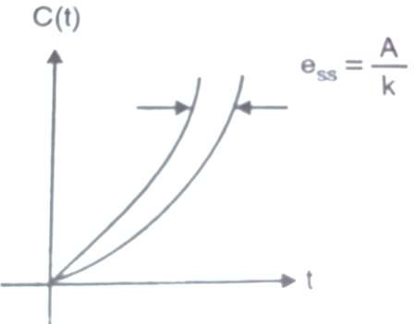
Steady state error for Parabolic input for Type 2 system
ess(t) = ^{A}
K
There is finite steady state error for type two system

Slide 167
steady state error and Type of
Relation between system
Summary:
Sr. No. | Type of System | Step Input |  | Ramp Input |  | Parabolic Input
 |  | K_{P} | ^{e}ss | K_{V} | ^{e}ss | K_{a} | ^{e}ss
1 | Zero | K | A 1+ K | 0 | ∞ | 0 | ∞
2 | One | ∞ | 0 | K | A K | 0 | ∞
3 | Two | ∞ | 0 | ∞ | 0 | K | A K

Slide 168
Module II – Time Response Analysis
Time Domain Analysis
Transient and Steady State Response
Standard Test Inputs : Step, Ramp, Parabolic and Impulse, Need, Significance
and corresponding Laplace Representation
Poles and Zeros : Definition, S-plane representation
First and Second order Control System
First Order Control System : Analysis for step Input, Concept of Time Constant
Second Order Control System : Analysis for step input, Concept, Definition and
effect of damping
Time Response Specifications
Time Response Specifications ( no derivations )
Tp, Ts, Tr, Td, Mp, ess – problems on time response specifications
Steady State Analysis – Type 0, 1, 2 system, steady state error constants
Problems on Steady State Error & Error constants

Slide 169
Example 18
The control system having unity feedback has,
20
G(s) =
s(1+ 4s)(1+ s)
Determine
1. Different static error coefficients.
_{t} 2
2. Steady State error if input
r(t) = 2 + 4t +
2

Slide 170
Example 18
cont……
Solution:
Position error constant,
Kp = lim G(s)H (s)
s →0
20
Kp = lim
s →0
s(1 + 4s)(1 + s)
20
Kp =
0(1 + 4s)(1 + s)
Kp = ∞

Slide 171
Example 18
cont……
Velocity error constant,
Kv = lim sG(s)H (s)
s →0
20
Kv = lim s[
]
s →0
s(1 + 4s)(1 + s)
20
Kv =
(1 + 4s)(1 + s)
Kv = 20

Slide 172
Example 18
cont……
Acceleration error constant,
Ka = lim s²G(s)H (s)
s →0
20
Ka = lim s² [
]
s →0
s(1 + 4s)(1 + s)
20
Ka = 0[
]
s(1 + 4s)(1 + s)
Ka = 0

Slide 173
Example 18
cont……
Steady state error, for
2
t
2
r(t) = 2 + 4t
4
1
R(s) = L{r (t )} = ² +
+
s
Steady state error is given by,
_{s}2 _{s}3
sR(s)
eSS = lim
^{s →0} 1 + G(s)H (s)
4
1 ]
s[ ² +
+
s
_{s}2 _{s}3
eSS = lim
s →0
1 +
20
s(1 + 4s)(1 + s)
eSS = ∞

Slide 174
Example 19
The control system having unity feedback has,
_{G(s) =} 50(s + 5)
_{s}2
Determine
1. Different static error coefficients.

Slide 175
Example 19
cont……
Solution:
Position error constant,
Kp = lim G(s)H (s)
s →0
_{= lim} 50(s + 5)
Kp
_{s}2
s →0
₌ 50(s + 5)
Kp
(0)²
Kp = ∞

Slide 176
Example 19
cont……
Velocity error constant,
Kv = lim sG(s)H (s)
s →0
_{= lim s[} 50(s + 5)]
Kv
_{s}2
s →0
_{= lim} 50(s + 5)
Kv
s →0
s
₌ 50(s + 5)
Kv
0
Kv = ∞

Slide 177
Example 19
cont……
Acceleration error constant,
Ka = lim s²G(s)H (s)
s →0
_{= lim s2 [} 50(s + 5)]
Ka
_{s}2
s →0
Ka = lim 50(s + 5)
s →0
Ka = 250

Slide 178
Example 20
The control system having,
20
10
G(s) =
H (s) =
s(s² + 2s + 5)
(s + 4)
Determine
1. Different static error coefficients.
_{t} 2
2. Steady State error if input
r(t) = 5 +10t +
2

Slide 179
Example 20
cont……
Solution:
Position error constant,
Kp = lim G(s)H (s)
s →0
20
10
Kp = lim
×
s →0
s(s² + 2s + 5)
(s + 4)
Kp = ∞

Slide 180
Example 20
cont……
Velocity error constant,
Kv = lim sG(s)H (s)
s →0
20
10
Kv = lim s[
×
]
s →0
s(s² + 2s + 5)
(s + 4)
₌ 200
Kv
20
Kv = 10

Slide 181
Example 20
cont……
Acceleration error constant,
Ka = lim s²G(s)H (s)
s →0
20
10
Ka = lim s² [
×
]
s →0
s(s² + 2s + 5)
(s + 4)
20 10
Ka = 0[
×
]
(s² + 2s + 5) (s + 4)
Ka = 0

Slide 182
Example 20
cont……
Steady state error, for
2
t
r(t) = 5 +10t
2
1
R(s) = L{r (t )} = ⁵ + ¹⁰ +
s
Steady state error is given by,
_{s}2 _{s}3
sR(s)
eSS = lim
^{s →0} 1 + G(s)H (s)
1 ]
s[ ⁵ + ¹⁰ +
s
20
_{s}2 _{s}3
eSS = lim
10
s(s² + 2s + 5) (s + 4)
s →0
1 + [
×
]
eSS = ∞

Slide 183
Example 21
The control system having unity feedback has,
20(1+ s)
G(s) =
s² (2 + s)(4 + s)
Determine
1. Different static error coefficients.
2. Steady State error if input
r(t) = 40 + 2t + 5t ²

Slide 184
Example 21
cont……
Solution:
Position error constant,
Kp = lim G(s)H (s)
s →0
20(1 + s)
Kp = lim
s →0
s² (2 + s)(4 + s)
20(1 + s)
Kp =
0² (2 + s)(4 + s)
Kp = ∞

Slide 185
Example 21
cont……
Velocity error constant,
Kv = lim sG(s)H (s)
s →0
20(1 + s)
Kv = lim s[
]
s →0
s² (2 + s)(4 + s)
20(1 + s)
Kv = lim[
]
s →0
s(2 + s)(4 + s)
Kv = ∞

Slide 186
Example 21
cont……
Acceleration error constant,
Ka = lim s²G(s)H (s)
s →0
20(1 + s)
Ka = lim s² [
]
s →0
s² (2 + s)(4 + s)
20(1 + s)
Ka = lim[
]
s →0
(2 + s)(4 + s)
₌ 5
Ka
2

Slide 187
Example 21
cont……
Steady state error, for
r(t) = 40 + 2t + 5t ²
2 ₊ 10
_{s}2 _{s}3
R(s) = L{r (t )} = ⁴⁰ +
s
Steady state error is given by,
sR(s)
eSS = lim
^{s →0} 1 + G(s)H (s)
2 ₊ 10 ]
_{s}2 _{s}3
s[ ⁴⁰ +
eSS = lim
s
s →0 20(1 + s) 1 +
s² (2 + s)(4 + s)
eSS = 4

Slide 188
Example 22
The control system having unity feedback has,
20(s +1)
G(s) =
s(s + 2)(s² + 2s + 2)
Determine
1. Different static error coefficients.
2. Steady State error if input
r(t) = 10 + 20t

Slide 189
Example 22
cont……
Solution:
Position error constant,
Kp = lim G(s)H (s)
s →0
20(s + 1)
Kp = lim
s →0
s(s + 2)(s² + 2s + 2)
20(s + 1)
Kp =
0(s + 2)(s² + 2s + 2)
Kp = ∞

Slide 190
Example 22
cont……
Velocity error constant,
Kv = lim sG(s)H (s)
s →0
20(s + 1)
Kv = lim s[
]
s →0
s(s + 2)(s² + 2s + 2)
20(s + 1)
Kv = lim[
]
s →0
(s + 2)(s² + 2s + 2)
Kv = 5

Slide 191
Example 22
cont……
Acceleration error constant,
Ka = lim s²G(s)H (s)
s →0
20(s + 1)
Ka = lim s² [
]
s →0
s(s + 2)(s² + 2s + 2)
20(s + 1)
Ka = lim s[
]
s →0
(s + 2)(s² + 2s + 2)
Ka = 0

Slide 192
Example 22
cont……
Steady state error, for
r(t) = 10 + 20t
R(s) = L{r (t )} = ¹⁰ + ²⁰
s
_{s}2
Steady state error is given by,
sR(s)
eSS = lim
^{s →0} 1 + G(s)H (s)
10 20
s[ + ]
s s²
eSS = lim
s →0 20(s + 1) 1 +
s(s + 2)(s² + 2s + 2)
eSS = 4

Slide 193
Example 23
The control system having unity feedback has,
20(s + 4)
G(s) =
s(s + 2)(s² + 2s + 2)
Determine
1. Different static error coefficients.
2. Steady State error if input
r(t) = 6t + ³ t ²
2

Slide 194
Example 23
cont……
Solution:
Position error constant,
Kp = lim G(s)H (s)
s →0
20(s + 4)
Kp = lim
s →0
s(s + 2)(s² + 2s + 2)
20(s + 4)
Kp =
0(s + 2)(s² + 2s + 2)
Kp = ∞

Slide 195
Example 23
cont……
Velocity error constant,
Kv = lim sG(s)H (s)
s →0
20(s + 4)
Kv = lim s[
]
s →0
s(s + 2)(s² + 2s + 2)
20(s + 4)
Kv = lim[
]
s →0
(s + 2)(s² + 2s + 2)
Kv = 20

Slide 196
Example 23
cont……
Acceleration error constant,
Ka = lim s²G(s)H (s)
s →0
20(s + 4)
Ka = lim s² [
]
s →0
s(s + 2)(s² + 2s + 2)
20(s + 4)
Ka = lim s[
]
s →0
(s + 2)(s² + 2s + 2)
Ka = 0

Slide 197
Example 23
cont……
Steady state error, for
r(t) = 6t + ³ t ²
2
6 3
R(s) = L{r (t )} =
+
_{s}2 _{s}3
Steady state error is given by,
sR(s)
eSS = lim
^{s →0} 1 + G(s)H (s)
3 ]
s[ ⁶ +
_{s}2 _{s}3
eSS = lim
s →0 20(s + 4) 1 +
s(s + 2)(s² + 2s + 2)
eSS = ∞

Slide 198
Example 24
The open loop transfer function of servo system with unity feedback is,
10
G(s) =
s(0.1s +1)
Determine
1. Different static error coefficients.
2. Steady State error if input
r(t) = a0 + a1t + ^{a2} t ²
2

Slide 199
Example 24
cont……
Solution:
Position error constant,
Kp = lim G(s)H (s)
s →0
10
Kp = lim
s →0
s(0.1s + 1)
10
Kp =
0(0.1s + 1)
Kp = ∞

Slide 200
Example 24
cont……
Velocity error constant,
Kv = lim sG(s)H (s)
s →0
10
Kv = lim s[
]
s →0
s(0.1s + 1)
10
Kv = lim[
]
s →0
(0.1s + 1)
Kv = 10

Slide 201
Example 24
cont……
Acceleration error constant,
Ka = lim s²G(s)H (s)
s →0
10
Ka = lim s² [
]
s →0
s(0.1s + 1)
10
Ka = lim s[
]
s →0
(0.1s + 1)
Ka = 0

Slide 202
Example 24
cont……
Steady state error, for
r(t) = a0 + a1t + ^{a2} t ²
2
₊ a1 ₊ a2
_{s}2 _{s}3
R(s) = L{r (t )} = ^{a0}
s
Steady state error is given by,
sR(s)
eSS = lim
^{s →0} 1 + G(s)H (s)
_{s[} a0 ₊ a1 ₊ a2 ]
_{s}2 _{s}3
10
eSS = lim
s
s →0
1 +
s(0.1s + 1)
eSS = ∞

Slide 203
Example 25
The open loop transfer function of servo system with unity feedback is,
10
G(s) =
s² (1+ s)
Determine
1. Different static error coefficients.
2. Steady State error if input
r(t) = a0 + a1t + a2t ²

Slide 204
Example 25
cont……
Solution:
Position error constant,
Kp = lim G(s)H (s)
s →0
10
Kp = lim
s →0
s² (1 + s)
10
Kp =
0² (1 + s)
Kp = ∞

Slide 205
Example 25
cont……
Velocity error constant,
Kv = lim sG(s)H (s)
s →0
10
Kv = lim s[
]
s →0
s² (1 + s)
10
Kv = lim[
]
s →0
s(1 + s)
Kv = ∞

Slide 206
Example 25
cont……
Acceleration error constant,
Ka = lim s²G(s)H (s)
s →0
10
Ka = lim s² [
]
s →0
s² (1 + s)
10
Ka = lim[
]
s →0
(1 + s)
Ka = 10

Slide 207
Example 25
cont……
Steady state error, for
r(t) = a0 + a1t + a2t ²
₊ a1 ₊ 2a2
_{s}2 _{s}3
R(s) = L{r (t )} = ^{a0}
s
Steady state error is given by,
sR(s)
eSS = lim
^{s →0} 1 + G(s)H (s)
_{s[} a0 ₊ a1 ₊ 2a2 ]
_{s}2 _{s}3
10
eSS = lim
s
s →0
1 +
s² (1 + s)
a2
eSS =
5

Slide 208
Example 26
A unity feedback system is characterized by the open loop transfer function is,
1
G(s) =
s(0.5s +1)(0.2s +1)
Determine steady state errors for unit step input, unit ramp input and unit acceleration input.

Slide 209
Example 26
cont……
Solution:
Position error constant,
Kp = lim G(s)H (s)
s →0
1
Kp = lim
s →0
s(0.5s + 1)(0.2s + 1)
Kp = ∞
Steady state error for unit step input is given by,
1
ess(t) =
1 + Kp
1
ess(t) =
1 +∞
ess(t) = 0

Slide 210
Example 26
cont……
Velocity error constant,
Kv = lim sG(s)H (s)
s →0
1
Kv = lim s[
]
s→0
s(0.5s + 1)(0.2s + 1)
Kv = 1
Steady state error for unit ramp input is given by,
1
ess(t) =
Kv
ess(t) = ¹
1
ess(t) = 1

Slide 211
Example 26
cont……
Acceleration error constant,
Ka = lim s²G(s)H (s)
s →0
1
Ka = lim s² [
]
s→0
s(0.5s + 1)(0.2s + 1)
Ka = 0
Steady state error for unit parabolic input is given by,
1
ess(t) =
Ka
ess(t) = ¹
0
ess(t) = ∞

Slide 212

References
Control System Engineering
J. J. Nagrath, M. Gopal
Feedback Control System
R. A. Barapate
Modern Control Engineering
K. Ogata
212

Slide 213

Online Tutorials
http://www.electrical4u.com
/control-engineering- historical-review-and-types- of-control-engineering/
http://www.academia.edu/6 729369/EC2255-
_Control_System_Notes_solv ed_problems_
11/21/2016
Amit Nevase
213

Slide 214
Thank You
214

